Slide 1
Just Like You
Stage 3 - workshop A
April 2019

Slide 2
Key
BCOs = Behaviour Change Outcomes, the states this workshop seeks to create in its audience:
Attitude: The emotional disposition necessary for behaviour change.
Knowledge: The information essential to facilitating behaviour change.
Self-Efficacy: The practice of new behaviours.
Behavioural Intention: The articulation of and commitment to changed behaviour.
Learning Outcomes = Expression of BCOs for market-facing contexts (e.g. for teachers).
CPD = ‘Concept, Principles & Details’, an information map that summarises content over three tiers – from the top-line Concept down to the specific Details.
At the Principles level, a workshop’s CPD correlates to the BCOs in the following sequence:
Introduction = Attitude
Principle 1 = Knowledge
Principle 2 = Self-Efficacy
Conclusion = Behavioural Intention
Summary = A short description of the scripted content of an individual slide.
Notes:
N.B. Slide for facilitator training only. Please keep ‘hidden’ and DO NOT present to audiences. Always use the ‘SLIDE SHOW’ function with ‘Use Presenter View’ activated when in front of audiences.

Slide 3
Australian curriculum
Version 9.0
Health and Physical Education
Explain how identities can be influenced by people and places, and how we can create positive self-identities (AC9HP6P01)
Describe and demonstrate how respect and empathy can be expressed to positively influence relationships (AC9HP6P04)
Describe and implement strategies to value diversity in their communities (AC9HP6P05)
Analyse and rehease protective behaviours and help-seeking strategies that can be used in a range of online and offline situations (AC9HP6P08)
Analyse how behaviours influence the health, safety, relationships and wellbeing of individuals and communities (AC9HP6P10)
English
Understand how to move beyond making bare assertions by taking account of differing ideas or opinions and authoritative sources (AC9E5LA02)
Personal and Social Capability (General Capability)
Explain how the ability to appreciate others’ needs, emotions, cultures and backgrounds assists in the development of social awareness
Explain the way their actions and the actions of others influence communities
Notes:
N.B. Slide for facilitator training only. Please keep ‘hidden’ and DO NOT present to audiences. Always use the ‘SLIDE SHOW’ function with ‘Use Presenter View’ activated when in front of audiences.

Slide 4
Australian curriculum
Version 9.0
Critical and Creative Thinking (General Capability)
Create possibilities by connecting or creatively expanding on new and known ideas in a variety of ways
Consider alternatives by challenging or creatively adjusting existing ideas in situations where current approaches do not work and recommend a preferred option
Ethical Understanding (General Capability)
Identify and describe ethical concepts, such as truth and justice, and explain how perspectives may vary according to the situation or context
Describe how values, rights and responsibilities, and shared expectations influence responses and decision-making
Notes:
N.B. Slide for facilitator training only. Please keep ‘hidden’ and DO NOT present to audiences. Always use the ‘SLIDE SHOW’ function with ‘Use Presenter View’ activated when in front of audiences.

Slide 5
Structure
Concept
Introducing and applying the Social Model of Disability
Introduction
Students feel invested in changing society’s attitude towards disability.
Principle 1
Students understand the Social Model
of Disability.
Principle 2
Students can identify practical steps to implementing the Social Model of Disability
Conclusion
Students commit to applying the Social Model
of Disability
Attitude
Knowledge
Self-Efficacy
Behavioural Intention
Notes:
N.B. Slide for facilitator training only. Please keep ‘hidden’ and DO NOT present to audiences. Always use the ‘SLIDE SHOW’ function with ‘Use Presenter View’ activated when in front of audiences.

Slide 6
3A
Notes:
Pre-workshop conversation with teacher
Logistics:
Time: X minutes; from when until when
Physical environment: Remove barriers; bring audience closer; all bags/distractions away
Teacher assistance:
Volunteers: Relate to the teacher that at several points in the workshop, we will want student volunteers to help out the front. We will call on the teacher at such times to recommend students who will be responsible enough to assist the facilitator in front of their classmates.
Activities: Request that the teacher be ready to assist with behaviour management, in particular to ‘keep an eye on things’ at the back of the workshops space. In addition, relate that during any group work, it’d be great for the teacher to assist in the monitoring of students’ activities (e.g. in Stage 1B’s Party Games section).
Introduction to the class
Yourself:
Name
Program: Just Like You! – we visit schools all across Sydney to talk about disability awareness.
Disability: <<Insert facilitator’s own self-intro here: keep brief!>> Example: “You might have noticed that I’m in a wheelchair. That’s because I have a disability called cerebral palsy. We’ll talk a bit more about that next week, but for now, all you have to know is that even though I need a wheelchair to get around, I’m just like you guys! I love pizza and watching Transformers and playing with my dog.”
Workshop set-up:
Stage 1.1 – a discussion about how we are all people, no matter what we look like, where we come from, or what disabilities we might have.
Set behavioural expectations (i.e. Today’s a conversation, school standards…)
Segue out:
“Today, we are not going to be talking about me - we are going to talk about a friend of mine…”

Slide 7
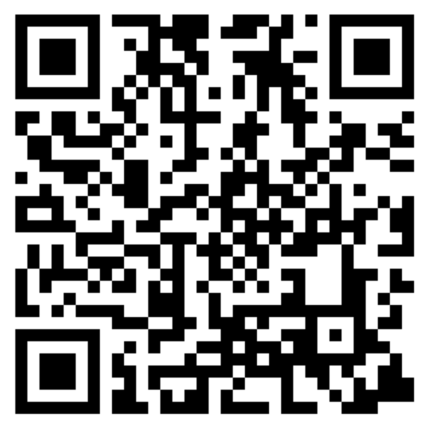
Thank You
bit.ly/2MCOb5k

Slide 8
3A
Notes:
Pre-workshop conversation with teacher
Logistics:
Time: X minutes; from when until when
Physical environment: Remove barriers; bring audience closer; all bags/distractions away
Teacher assistance:
Volunteers: Relate to the teacher that at several points in the workshop, we will want student volunteers to help out the front. We will call on the teacher at such times to recommend students who will be responsible enough to assist the facilitator in front of their classmates.
Activities: Request that the teacher be ready to assist with behaviour management, in particular to ‘keep an eye on things’ at the back of the workshops space. In addition, relate that during any group work, it’d be great for the teacher to assist in the monitoring of students’ activities (e.g. in Stage 1B’s Party Games section).
Introduction to the class
Yourself:
Name
Program: Just Like You! – we visit schools all across Sydney to talk about disability awareness.
Disability: <<Insert facilitator’s own self-intro here: keep brief!>> Example: “You might have noticed that I’m in a wheelchair. That’s because I have a disability called cerebral palsy. We’ll talk a bit more about that next week, but for now, all you have to know is that even though I need a wheelchair to get around, I’m just like you guys! I love pizza and watching Transformers and playing with my dog.”
Workshop set-up:
Stage 1.1 – a discussion about how we are all people, no matter what we look like, where we come from, or what disabilities we might have.
Set behavioural expectations (i.e. Today’s a conversation, school standards…)
Segue out:
“Today, we are not going to be talking about me - we are going to talk about a friend of mine…”

Slide 9
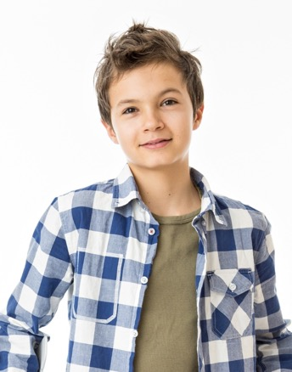
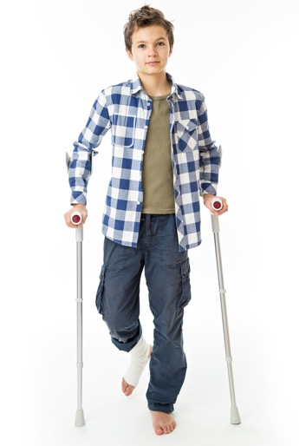



Meet Jack
Notes:
Segue in:
“I’d like you guys to meet someone just like you.”
Story:
This is Jack – he’s in Grade 5-6 and he goes to school just like you guys.
He loves the colour black and Minecraft and playing the piano.
While he was running down some stairs, Jack fell and broke his leg.
Discussion:
Has anyone here ever broken an arm or a leg or any other bones before?
Did you have to get a cast?
Has anyone ever had to use crutches or a wheelchair?
How did people treat you?
Was that different to the way they usually treated you?
How were you able to participate in games and other activities?
Did you get left out at all?
Did you feel put down?
Did you feel like you were a problem rather than a person?
How did the way people treat you change?
Did you feel left out or excluded?
Did you ever feel like you were a hassle?
Segue out:
“Who hasn’t had a broken leg before? What do you think it might be like? Let’s find out with a quick game!”

Slide 10
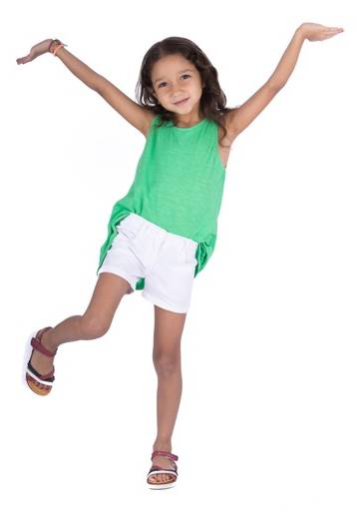
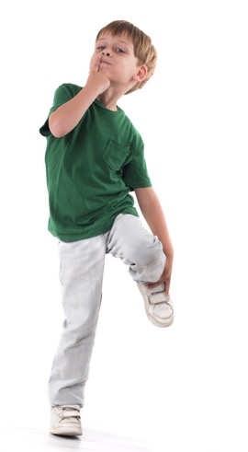
Stepping Into Other
People’s Shoes
Notes:
JW- Empathy and sympathy
Imagine back- don’t do activity
Intention: This activity is an engagement piece that aims to gain audience involvement and introduce some of the topics students will be thinking about and gives a simple reference point to help develop empathy by spending a moment in someone else’s shoes.
Segue in:
“Let’s step into Jack’s shoes for a minute, and see what life might be like if you didn’t have the full use of both of your legs.”
Activity:
Direct students to stand up and balance on one leg.
“How did you find that?”
Next, ask them to also close their eyes as they’re on one leg – most will wobble or topple.
“Was that a bit harder?”
Finally, with their eyes still closed and standing on one leg, ask them to touch their fingers to their nose and/or hop.
“Now, how was it that time?”
Discussion:
Do you think life would be easier or harder with the use of only one leg?
What else might be hard If something as simple as standing on one leg with our eyes closed is challenging?
Segue out:
In this activity you’ve been practicing what it’s like to be in someone else's shoe’s. The technical term for that is empathy, and it’s something that’s really important for everyone to develop skills in.
“Jack hopes his leg won’t be a problem as he heads back to school for his first day since his accident.”

Slide 11
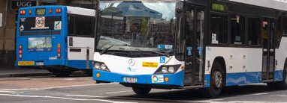
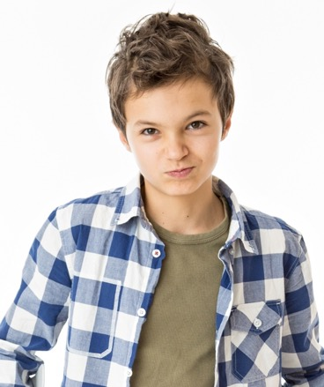

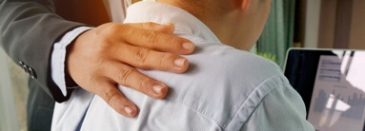
Why is This So Hard?_
Notes:
JW: Why would this be so difficult?
Segue in:
“Jack thought having a broken leg might be kind of fun – crutches can be pretty cool to play on!”
Story:
Unfortunately the first day back after the accident is turning out to be tough…
In the morning…At his first day back, Jack had trouble getting on the school bus.
At lunchtime…One of his friends called Jack ‘lame-o’.
In the afternoon…Jack’s teacher was treating him differently and saying things like “Oh, poor Jacky, you don’t have to do any maths today,” and now Jack’s friends are mad at him.
Discussion:
Why do you think having a broken leg might make it harder to use public transport?
The steps were too high
Why do you think Jack’s friends are being weird? Hint: What’s Jack’s favourite sport?
Jack couldn’t play footy at lunch with the team
What was going on with Jack’s teacher?
Being patronising and thinking Jack couldn’t do something using his brain just because his leg is injured.
Apart from the physical difficulty, what are some of the other barriers affecting Jack?
Name calling and the way people are acting towards you. What’s that called?
Attitude!
What are some of the outcomes of these attitudes?
Jack could feel and/or start to become isolated/sad/angry…even falling behind in school
Segue out:
“Jack is starting to think his broken leg isn’t the real problem here – it’s all the other barriers in his way, both the physical ones and the ones created by people in our society!”

Slide 12
Our Society and Disability
Notes:
Segue in:
“Let’s take a quick couple of minutes to talk about our Society”.
Discussion:
Who can help me with a definition of a society?
Our simple definition is: Our society is a collection of people, culture and the environment and it’s easy to remember using this graphic.
The main things I want to focus on with you guys today is our attitudes, our language and communication and opportunities and access. They are really big parts of our society that effect people with a disability – unfortunately - often more seriously than they affect others in our society.
I want to help us think about our society and how we all effect each other by doing a quick activity:
Activity:
Who knows what a metaphor is? You know, when someone tells a story that isn’t true but it always has a “moral of the story” you can use in real life?
Well we’re about to make our own!
Pick out 6 volunteers; 1x blindfolded not talking, 1x a guide that can help, 3x “bad attitude”, 1x physical barrier with legs out.
Ask all students except for blindfolded and the guide to sit in two lines on the floor facing each other, making a narrow pathway between them
ROUND 1: Ask student with blindfold to get from A to B. The guide can only use one word instructions and must remain at the start of the path, students with “bad attitude” calling out names and student with legs out as obstacles crossing the path.
ROUND 2: Ask student with blindfold to get from A to B. The guide can use full conversation, student now has a “good attitude” encouraging and the obstacle is now removed completely.
Discussion:
What did you think about getting through our maze?
That maze is actually a metaphor (a story) for our society. It can be hard to navigate but if we all help each other and remove barriers where we can then it will be better for everyone!
It’s up to us all to have empathy for everyone around us in society – especially those with a disability that often find things more difficult – and unravel the complicated maze that our world can seem like to some people.
Let’s think about this metaphor and how it applies to our life? What are some examples of obstacles that affect others
Remember: It’s not the blindfold (disability) that made the maze hard, it was the people (barriers in our society).
Segue out:
They are many possible barriers for people with a disability. Our attitudes, our language and accessibility are all possible barriers for people with a disability. If a barrier is in your way and stopping you from achieving something, what do you do with it?
We have to remove barriers that restrict people with disabilities from and prevent everyone from being truly equal.
“The way we should be trying to live in our society is to make sure that everyone is treated equally and fairly. It is not the inability to walk that stops someone in a wheelchair from getting on a bus – it’s the bus steps that make it hard! When there are no barriers, everyone is independent and equal in society.”

Slide 13


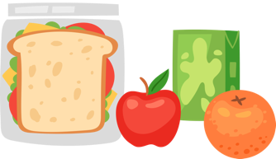
Attitude
Notes:
Segue in:
“For people that have an impairment or a disability, things that a lot of people take for granted can be a lot harder. Let’s look at why.”
Discussion:
Let’s look at attitude first – what does the term Attitude mean?
Take suggestions from the class, then lead the discussion around to a definition like:
“A manner of acting, feeling, or thinking that shows one's mood or opinion”
Activity:
Let’s do an experiment about attitude…
Ask the students to tell you which of the two lunch bags will have the better lunch inside.
Reveal that both contain the exact same lunch.
“Often, when people are talking with someone with a disability, their attitude can be based on appearances. People can act mean or patronising as if the person with a disability can’t do anything at all.
Segue out:
“The good news is that by being here today as part of the Just Like You! program, you’re improving your awareness of disability and your ability to recognise and improve your attitudes.
It’s important to make sure our attitude is the same to everyone around us, because just like the lunch bags, we don’t know who they are on the inside yet or what amazing things they’re capable of.

Slide 14
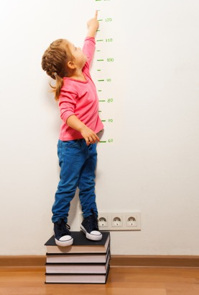
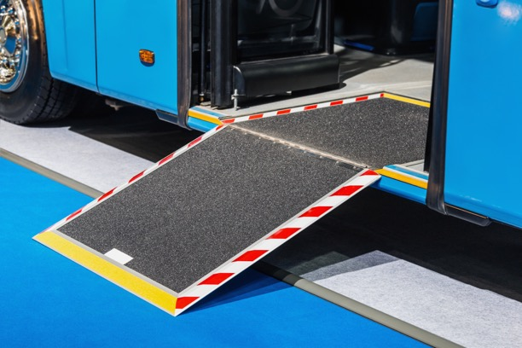
Opportunities and Accessibility
Notes:
egue in:
“Do you ever think about the opportunities you have all around you? All the options of different things you can do and places you can go? What would it be like if you didn’t have them?”
Discussion:
Have you ever been too short to ride a rollercoaster? How did that make you feel?
It isn’t fun when all your friends are going on the ride just because of your height.
Can you control your height? No!
So, you would feel pretty bad if you were excluded from opportunities to do things just because you’re a bit different? Wouldn’t you?
Story:
One of Jacks friends – Sally - decides to throw a pool party, which would ordinarily be pretty fun but unfortunately Jack doesn’t get invited
Sally told Jack that he wasn’t invited because he isn’t supposed to go in the pool with his broken leg in a cast. Having his friend say this to him really upsets Jack.
Discussion:
Why do you think this upsets Jack?
There is more to a party than just swimming
Its about who you spend time with rather than the actual activity.
Party’s are about being around your friends
Remember: We shouldn’t be expecting people with a disability to change to suit us because they often can’t control how disability effects them. We should be able to empathise with them and change things so that everyone can be included in everything our society has to offer!
Story:
People can often miss out on opportunities due to things that some people take for granted. A good example is using accessibility features
What do you think that ramp on the bus is there for?
What would life be like if you had limited transport options - like a bus or train with big steps and narrow walkways?
What would life be like if you couldn’t get into certain buildings – like the movies or the shopping centre?
How do you think someone with a vision impairment could use technology (a tablet) to help with their school work or to have fun?
Segue out:
“When someone isn’t allowed the same opportunity as other people, just because they have a disability, that isn’t being inclusive; it’s excluding people! So isn’t it great that we’ve got some really great features of our society that promote inclusion?”

Slide 15
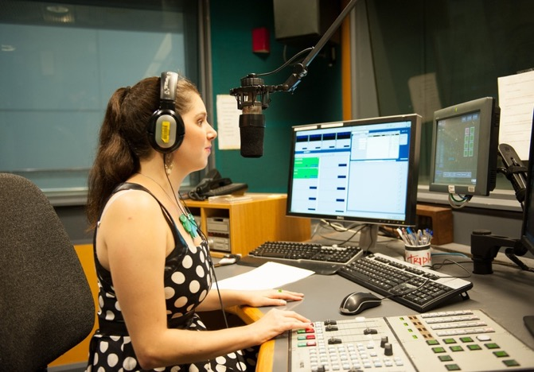
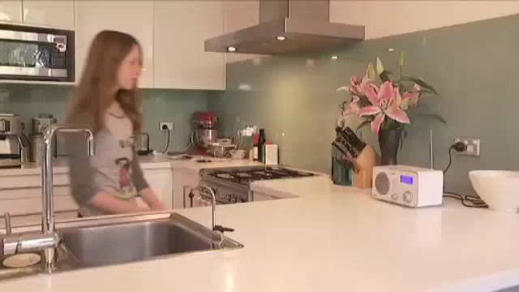

Meet Nas
Notes:
Segue in:
“This is Nas”
Story:
When she was in school, Nas wanted to be a journalist.
After going to uni, she beat 700 other people to land a job at the ABC as a news reporter.
Everyday, Nas gets to tell people on the radio all around Australia about what’s happening in the world.
Questions for the video:
Where does Nas work?
What is Nas’ accomplishment?
What is Nas’ disability?
Play the video
Story:
When she was in school, Nas wanted to be a journalist.
After going to uni, she beat 700 other people to land a job at the ABC as a news reporter.
Everyday, Nas gets to tell people on the radio all around Australia about what’s happening in the world.
Nas has a condition called Charcot-Marie-Tooth, which means she can’t read braille
When she reads the news, she listens to big headphones, and she reads the news as a voice reads it out to her.
The quality that has helped Nas the most is Positivity! Even when other companies knocked her back, she always believed in her ability.
Segue out:
“Wow! What an amazing bunch of people!”
Just like the superheroes we saw earlier, and you guys have become, you can imagine the types of challenges these people have faced to get where they are today – just like you.”

Slide 16
Braille Challenge
Notes:
Segue in:
“Now it’s your turn to learn a new language! Let’s have a go at communicating using Braille.”
Activity:
Class split into 3 groups
Each group works together to decode a braille sentence
Give the students 2 minutes to decode the Braille challenge
Take suggestions from the groups.
The sentence is, “My dog rides a bike.”
Segue out:
“Great work, you guys!”

Slide 17
Australian Sign Language
A
B
C
D
E
F
G
H
I
J
K
L
M
N
O
P
Q
R
S
T
U
V
W
X
Y
Z
Notes:
Segue in:
Can anyone here already speak sign language? Did you know that Sign language is different all around the world?
Australian sign language is called Auslan.”
Who wants to give it a go?
Activity:
In pairs, students are to use the Auslan alphabet to communicate to the other person an answer to the question: “What is your favourite food?”
Give students 2-3 minutes to practice using the alphabet and if some kids are really fast then ask them to spell their name!
How did you find using the Auslan alphabet?
What are some of the patterns you noticed with the Vowels? E.g. A, E, I, O and U?
What are some things you noticed about the letters e.g. S, V, W or X?
The Facilitator sign their own favourite food to the class and ask them to guess what it is.
Segue out:
“Great work, you guys! But what would happen if you had a vision impairment, we’re unable to speak and also had a physical disability that prevented you from using your hands for sign language?”

Slide 18
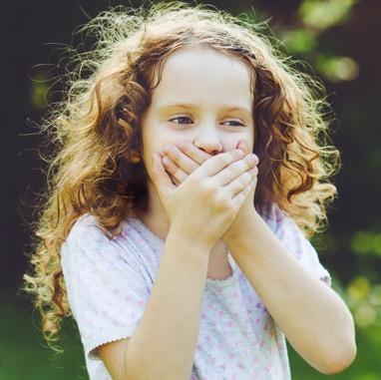

Language and
Communication
Notes:
Speak- look at the young and kids
Segue in:
“What about our language and the way we communicate?”
Activity:
Direct the students to pair up – one person can’t speak, lip sync or make any noises, the other must cover their eyes so they can’t see their partner. No communication by touching either!
Ask students to try and find out how they’re feeling today.
Discussion:
How did you find trying to communicate during that activity? Isn’t it hard to communicate without language?
How important is it for people to be able to communicate with each other?
Why is communication important? What do you need communication for?
Does anyone know how someone that is unable to speak could talk?
Where have you seen people communicating using their hands?
Does anyone know what that form of communication is called? Sign Language
Does anyone know how someone with a vision impairment could read?
Where have you seen small raised dots like a subtitle in a movie?
Does anyone know what that form of communication is called? Braille
Segue out:
“Communication is important – we need to try and make sure that no communication barriers limiting people.”

Slide 19

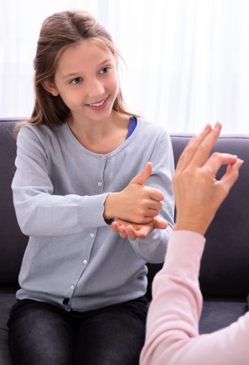

Communication!_
Notes:
Segue in:
“Now that we know a bit about the disability and our society and about attitudes, access, opportunities and communication, let’s work together to think of some ways we can remove barriers to people with a disability and how we can promote equality and inclusion.”
Discussion:
How can someone who is visually impaired read? (Audiobooks, Braille, High Contrast Screens)
How can someone who is hearing impaired understand others? (Sign Language, Lip Reading, Hearing Aid, Cochlear Implant)
How can someone who has speech difficulties ‘speak’? (Assistive Communication Devices)
What’s the main skill we’ve been working on developing today? Empathy.
Who can tell me what they think empathy means?
Why is it important for us to have empathy?
Segue out:
“There are plenty of ways we can remove the barriers to communication, we should start by thinking about all the things people can do, rather than what they can’t do.”

Slide 20
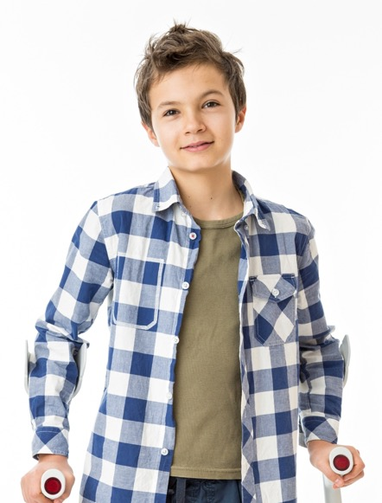
See you
next time!
Notes:
Segue in:
“Jack has learnt a lot about how the behaviour of people can have a big impact on others. He knows he can make better decisions when it comes to how he treats other people and he can even teach his friends a thing or two next someone from school has some kind of impairment.”
Activity:
Facilitator to ask the students to think of some of the limiting barriers spoken about during the workshop (language, attitude, opportunities)
Students to identify one thing they can do in their own lives to not be limiting with outer people.
“What I want you do think about over the next week is one way that you can make sure that you are helping remove barriers rather than being a barrier.”
Segue out:
“I’ll see you guys next week - it’s been so great being here today with you guys! Thanks so much be being great listeners. Now, please give your attention back to your teacher.”

Slide 21
Thank You
bit.ly/2MCOb5k

