Slide 1
Just Like You
Stage 2 - workshop A
April 2019

Slide 2
Key
BCOs = Behaviour Change Outcomes, the states this workshop seeks to create in its audience:
Attitude: The emotional disposition necessary for behaviour change.
Knowledge: The information essential
to facilitating behaviour change.
Self-Efficacy: The practice of new behaviours.
Behavioural Intention: The articulation of and commitment to changed behaviour.
Learning Outcomes = Expression of BCOs for market-facing contexts
(e.g. for teachers).
CPD = ‘Concept, Principles & Details’, an information map that summarises content over three tiers – from the top-line Concept down to the specific Details.
At the Principles level, a workshop’s CPD correlates to the BCOs in the following sequence:
Introduction = Attitude
Principle 1 = Knowledge
Principle 2 = Self-Efficacy
Conclusion = Behavioural Intention
Summary = A short description of the scripted content of an individual slide.
Notes:
N.B. Slide for facilitator training only. Please keep ‘hidden’ and DO NOT present to audiences. Always use the ‘SLIDE SHOW’ function with ‘Use Presenter View’ activated when in front of audiences.

Slide 3
Australian curriculum
Version 9.0
Health and Physical Education
Describe how valuing diversity influences wellbeing and identify actions that promote inclusion in their communities (AC9HP4P05)
Investigate and apply behaviours that contribute to their own and others’ health, safety, relationships and wellbeing (AC9HP4P10)
Investigate how success, challenge, setbacks and failure strengthen resilience and identities in a range of contexts (AC9HP4P01)
Describe how choices and actions can be influenced by stereotypes (AC9HP4P03)
Select, use and refine personal and social skills to establish, manage and strengthen relationships (AC9HP4P04)
Civics and Citizenship
Who makes rules, why rules are important in the school and/or the local community, and the consequences of rules not being followed (AC9HS3K06)
Why people participate within communities and how students can actively participate and contribute to communities (AC9HS3K07)
Notes:
N.B. Slide for facilitator training only. Please keep ‘hidden’ and DO NOT present to audiences. Always use the ‘SLIDE SHOW’ function with ‘Use Presenter View’ activated when in front of audiences.

Slide 4
Australian curriculum
Version 9.0
Personal and Social Capability (General Capability)
Explain the influence that their own behaviour has on the emotional responses of others
Discuss the value of different needs, emotions, cultures and backgrounds
Identify how they can contribute to healthy relationships and manage challenging relationships
Describe the various communities beyond their own and what they can do to support them
Ethical Understanding (General Capability)
Identify ethical concepts, such as respect and tolerance, and describe how a situation or context affects actions and behaviour
Describe the differences and connections between rights and responsibilities, and care and respect, and how these affect decision-making
Critical and Creative Thinking (General Capability)
Create possibilities by connecting or creatively expanding on new and known ideas in a variety of ways
Notes:
N.B. Slide for facilitator training only. Please keep ‘hidden’ and DO NOT present to audiences. Always use the ‘SLIDE SHOW’ function with ‘Use Presenter View’ activated when in front of audiences.

Slide 5
Structure
Concept
Develop empathy through understanding different disabilities
Introduction
Students are excited to learn more about disability
Principle 1
Students understand the varied causes and manifestations of disability
Principle 2
Students are able to empathise with challenges people with disabilities may face
Conclusion
Students identify daily activities that may pose a challenge to people with disability
Attitude
Knowledge
Self-Efficacy
Behavioural Intention
Notes:
N.B. Slide for facilitator training only. Please keep ‘hidden’ and DO NOT present to audiences. Always use the ‘SLIDE SHOW’ function with ‘Use Presenter View’ activated when in front of audiences.

Slide 6
2A
Notes:
N.B. Slide Pre-workshop conversation with teacher
Logistics:
Time: X minutes; from when until when
Physical environment: Remove barriers; bring audience closer; all bags/distractions away
Teacher assistance:
Volunteers: Relate to the teacher that at several points in the workshop, we will want student volunteers to help out the front. We will call on the teacher at such times to recommend students who will be responsible enough to assist the facilitator in front of their classmates.
Activities: Request that the teacher be ready to assist with behaviour management, in particular to ‘keep an eye on things’ at the back of the workshops space. In addition, relate that during any group work, it’d be great for the teacher to assist in the monitoring of students’ activities (e.g. in Stage 1B’s Party Games section).
Introduction to the class
Yourself:
Name
Program: Just Like You! – we visit schools all across Sydney to talk about disability awareness.
Disability: <<Insert facilitator’s own self-intro here: keep brief!>> Example: “You might have noticed that I’m in a wheelchair. That’s because I have a disability called cerebral palsy. We’ll talk a bit more about that next week, but for now, all you have to know is that even though I need a wheelchair to get around, I’m just like you guys! I love pizza and watching Transformers and playing with my dog.”
Workshop set-up:
Stage 2.A – a discussion about how different disabilities.
Set behavioural expectations (i.e. Today’s a conversation, school standards…)
Segue out:
“Today, we are going to step into someone else’s shoes. But first, we are going to talk about a friend of mine…”
facilitator training only. Please keep ‘hidden’ and DO NOT present to audiences. Always use the ‘SLIDE SHOW’ function with ‘Use Presenter View’ activated when in front of audiences.

Slide 7

Difference is Great
Notes:
Segue in:
Before we start todays workshop about understanding disability, lets talk about difference. Difference is one of the biggest positives in society.
Discussion:
Fac to lead a discussion around the positive impacts of difference (individuality, expression, variety)
Even though there are differences there are some things that are the same for everyone
Open ended questions about physical and emotional needs
Segue out:
As mentioned earlier today we are talking about disability

Slide 8
3 Types of Disability
Sensory
Physical
Hidden
Notes:
Segue in:
Lets talk about the three main types of disability
Activity:
Fac to give a brief summary of the three types of disability (physical, sensory and hidden)
Ask students what they know about disability and if they have had any experiences with friends or family members who have a disability (incorporating student participation by using open ended questions)
Segue Out:
Let’s get started on todays voyage, ooops! I mean lets get started on todays workshop

Slide 9
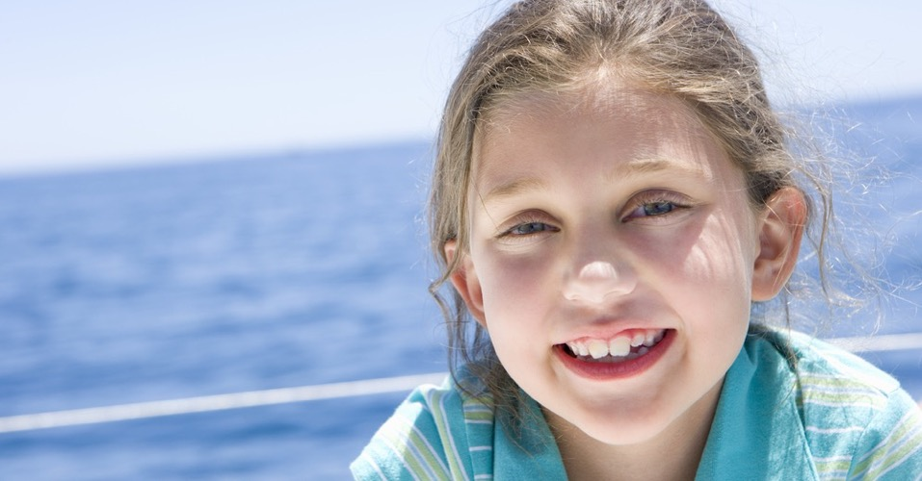




Meet Taylor!
Notes:
Segue in:
“I’d like you all to meet someone just like you.”
Story:
This is Taylor – she’s in Grade 3-4 and she goes to school just like you all.
She loves the colour blue and Minecraft and swimming.
Taylor has even seen a JLY session – exactly what you’re all doing right now!
Segue out:
“And today Taylor is doing something super exciting! Can you guess what?”
Talk to slide and reveal different aspects of a photo that shows taylor on the cruise ship

Slide 10

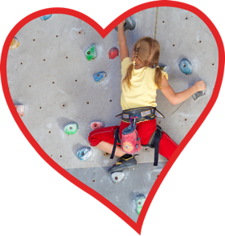

Holiday Time
Notes:
Segue in:
“She’s on a cruise!”
Story:
This year, Taylor’s family aren’t going to a caravan park or camping – they’re going on a cruise!
“And the best part about a cruise holiday are the activities!”
Taylor can’t wait to get on board, and do as many activities as possible. She is really looking forward to the Kids club where she wants to meet new friends.
Segue out:
“But before we can go aboard, we have to know the ship rules.”

Slide 11
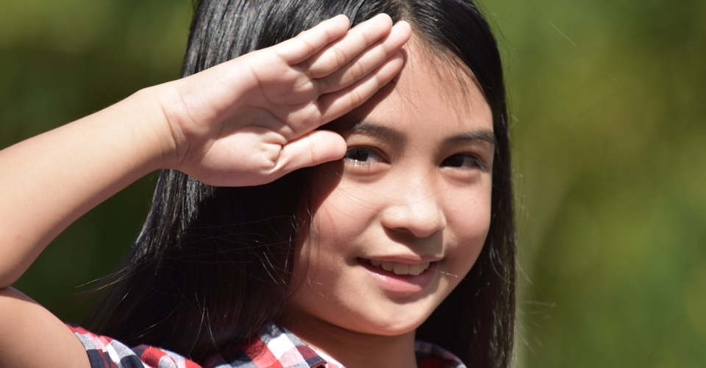
Captain’s Coming
Notes:
Segue in:
“Who’s the most important person on the ship? The captain! Today, I’ll be your captain during these workshops – so that means listening, and doing exactly as I say!”
Activity:
Game – Captain’s coming!
Explain to students they have to listen and follow the instructions carefully:
Captain’s coming! – Stand and salute.
To the port-side! – Lean or move to the left of the room.
To the starboard side! – Lean or move to the right of the room.
Person overboard! - Scan with a hand shielding eyes.
Hit the deck! - Crouch down.
Segue out:
“Great job, everybody! I think you’re ready to step aboard Taylor’s cruise…”
Intent:
The intention of this game is to get the audience engaged in the workshop. It is not part of the content as such. It helps to establish the Fac’s relationship to the audience by having a fun and physical activity. First engagement then empathy

Slide 12
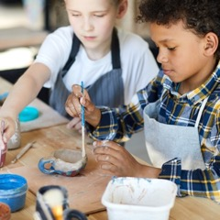
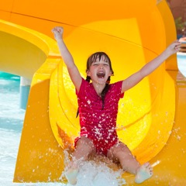
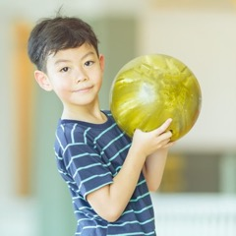
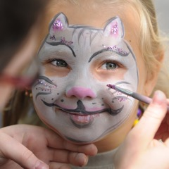
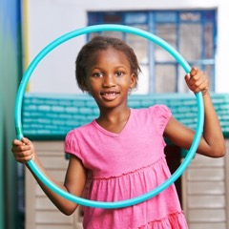
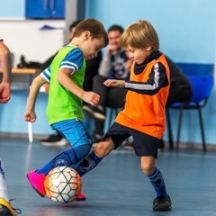
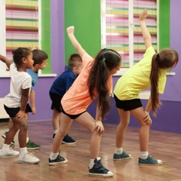
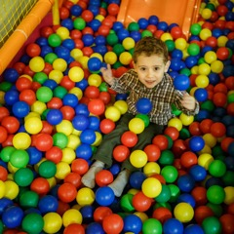
Kids Club
Notes:
Segue In:
“Taylor is super excited to be aboard the huge ship!”
Story:
After she has unpacked and checked out the cruise Taylor’s parents drop her off at the kids club. There are so many fun and cool things to do in the kids club.
Because of her experience in the JLY program, Taylor realises that there are some children who are not being included and she decides to hang out with these kids as she gets the feeling that they will have some of the same differences and interests as her.
As it turns out she makes 3 new friends that day and is so excited about spending more time with them over the coming days.
Segue out:
“Let’s meet Taylor’s friends…”

Slide 13
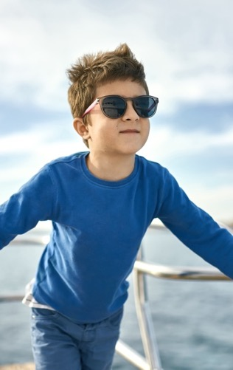
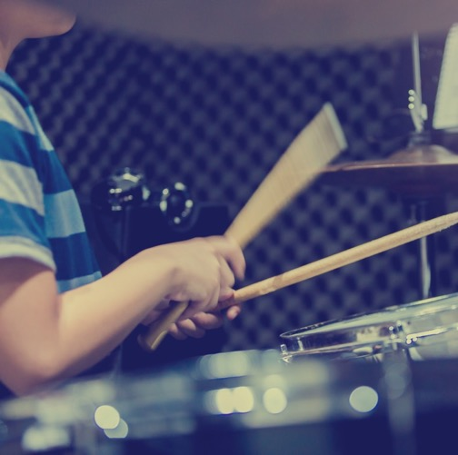

Vince
Notes:
Segue in:
“This is Vince”
Story:
Vince loves music, and he can play the drums!
What makes Vince a little different? He has difficulty seeing and uses a white stick – called a cane - to help him move around.
He has a disability called vision impairment.
Segue out:
“What do we know about vision impairment?”

Slide 14
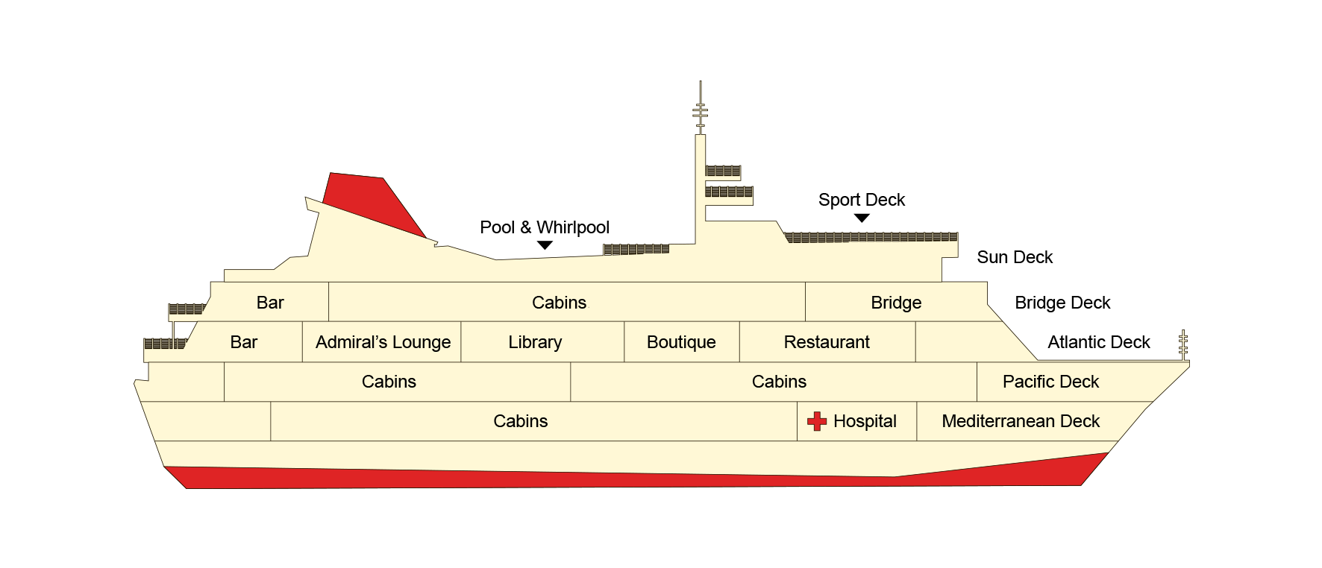
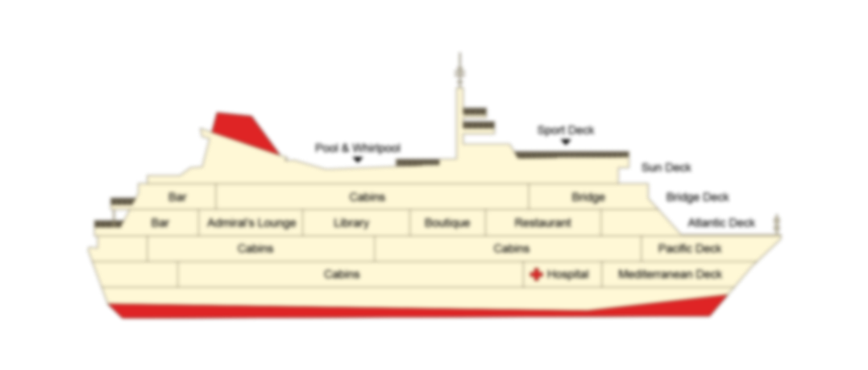

Vision Impairment
Notes:
Segue in:
“Vision Impairment means that you have loss of sight (vision – sight, impairment – disability).”
Discussion:
Facilitator to lead the discussion around Vision impairment. They must relay the following facts/topics:
Do you know there are different kinds of vision impairment? (tunnel vision, spots, total blindness, etc)
How does someone become visually impaired? (before you were born, accidents, deterioration)
What could be tricky for Vince on the cruise ship? (There can be sudden steps, some of the signs are hard to read, maps, etc)
Activity:
Students to try and find the sports deck on the map
Segue out:
“Taylor decides to check out the waterslides and pools”

Slide 15
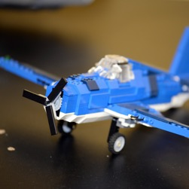
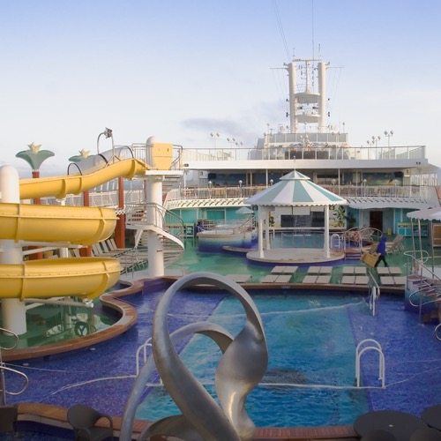
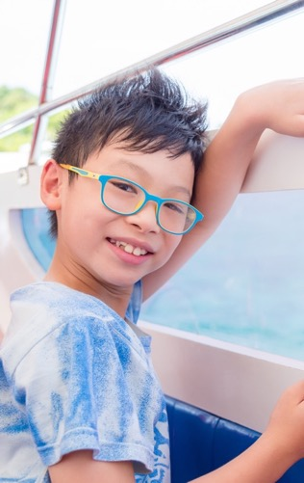
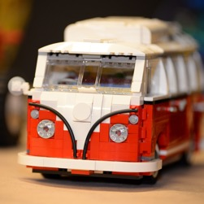
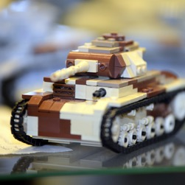
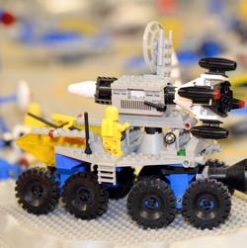
Andy
Notes:
Segue in:
“When Taylor is waiting to ride on the biggest and scariest slide “The Insane-o Jumbo-Drop” she bumps into her friend Andy.”
Story:
Andy tells Taylor that he’s already been on the slide 129 times!
As well as liking water slides Andy loves to make awesome Lego models.
What makes Andy a little different? He doesn’t like loud noises and sometimes finds it hard to understand people and how they’re feeling.
He has a disability called Autism.
Segue out:
“What do we know about autism?”

Slide 16
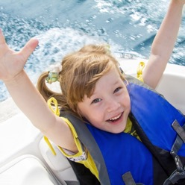
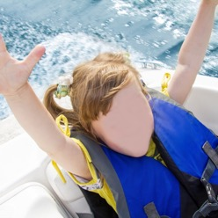
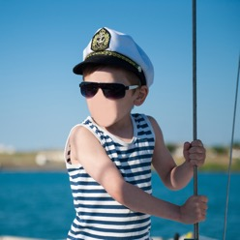

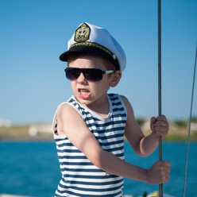
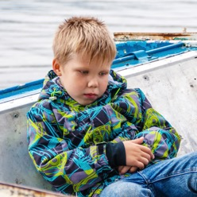

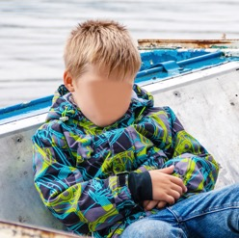
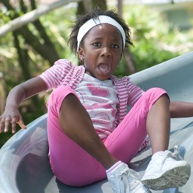
Autism Spectrum Disorder
sad
cranky
angry
embarrassed
nervous
scared
calm
happy
Notes:
Segue in:
“Autism means that something in your brain has developed differently – and it’s different for every person!”
Discussion:
Facilitator to lead the discussion around Autism. They must relay the following facts:
Autism is one of the more common disabilities about 1 in 70 Australians are estimated to be on the autism spectrum– and the majority of these are diagnosed as children
Children with Autism learn differently
Can you raise your hand if you know anyone with autism?
Autism affects people differently, it can affect social interaction, communication, repetitive behaviours and people can be more sensitive to sensory experiences (noises, lights, touch etc)
How do you get autism? (We don’t know for sure, but part of it is genetics – the way you’re born/made)
Activity:
“Taylor and Andy look at the people standing in line for the slide, and Taylor tries to guess how they’re feeling without looking at their faces.”
Students guess what the people in the pictures are feeling when they can’t see their faces.
Segue out:
“”

Slide 17
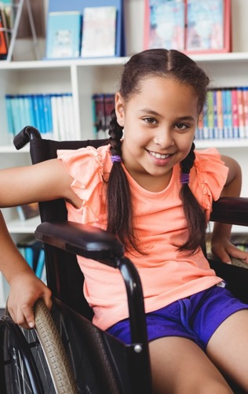
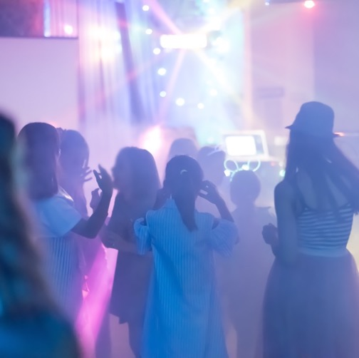

Polly
Notes:
Segue in:
“The Dance club is amazing. All of Taylor’s favourite songs are playing!”
Story:
Taylor meets Polly at the kid’s dance party. They both love the loud music and smoke machine! Its so loud that there are earmuffs for people!!
After dancing and singing Polly and Taylor go outside to talk.
What makes Polly a little different? Her legs don’t move very well, and she uses a wheelchair to get around.
She has a disability called cerebral palsy.
Segue out:
“What do we know about cerebral palsy?”

Slide 18
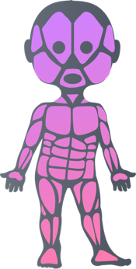


Cerebral Palsy (CP)
Notes:
Segue in:
“Cerebral palsy means that your brain was injured when you were a baby. It affects every person differently.”
Discussion:
Facilitator to lead the discussion around CP. They must relay the following facts:
Not everyone in a wheelchair has CP and not everyone with CP needs a wheelchair.
CP affects each person differently – it may be quite minor or severe depending on the person
People with CP may have another impairment (disability) as well – visual impairment, intellectual impairment.
Its not something you can catch from someone, like a cold.
Activity:
On next slide

Slide 19
Clasp hands together
with fingers intertwined
Fold arms upwards
Cross arms in front pointing down
Ask another person to point to a finger.
Try to lift that finger only.
Notes:
Activity:
“CP affects the way brain talks to the muscles. The damaged part of the brain can’t communicate with the part of the body controlled by that part of the brain.”
Students to put their arms out, face your palms out (to the walls), cross their arms, interlace their fingers and twist them back into their chests. Students attempt to lift individual fingers.
Ask students for their feedback
“Did anyone get the wrong finger moving?”
Segue out:
“Taylor’s first day on the cruise has been amazing! She has met some really cool people and spends the afternoon with her new friends at the kids club.”

Slide 20

Pick the Porthole!
How many Aussies have autism?
1 in 7
1 in 70
1 in 700
Notes:
Segue in:
“Taylor’s last activity today is a trivia quiz with her new friends. We’re going to do a quick quiz too, and see how much we remember about Taylor’s friends…”
Activity:
Pick the right port hole! Ask the students to raise their hands to show which porthole has the right answer.
How many Aussies have autism? (approximately 1 in 70) And remember many of these people are kids.
Segue out:
“Great job, everyone! Next question!”

Slide 21
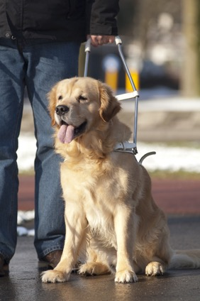
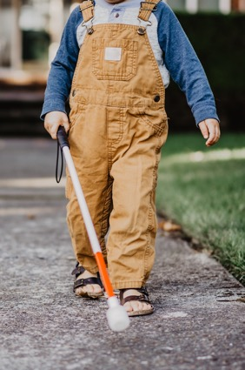
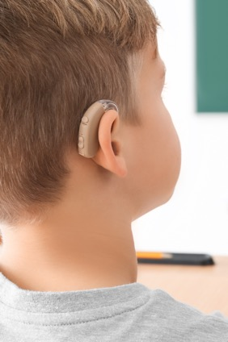
Which is the Odd One Out?
Notes:
Segue in:
“Look at these three pictures…”
Activity:
Which of these pictures is the odd one out?
Students to raise their hands to show their answer.
“The hearing aid is the odd picture – the cane and the dog are to help someone who is visually impaired.”
Segue out:
“Last question...”

Slide 22
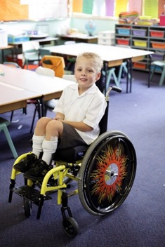
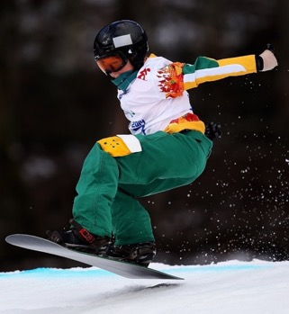


What Does Cerebral Palsy
Look Like?
PHOTO CREDIT: Getty Images
PHOTO CREDIT: Getty Images
Notes:
Segue in:
“This is a tricky question.”
Activity:
Which of these people have CP?
Answer – all of them! The kid on the snowboard is Ben Tudhope, who was an Aussie snowboarder at the Paralympics, and the lady in red is Jaqueline Freney, Young Australian of the Year, and Paralympic swimmer.
“CP looks different for every person, so you never know who might be affected.”
Segue out:
“Great job, everyone! We’ve learned a lot about Taylor’s new friends, and about disability too.”

Slide 23
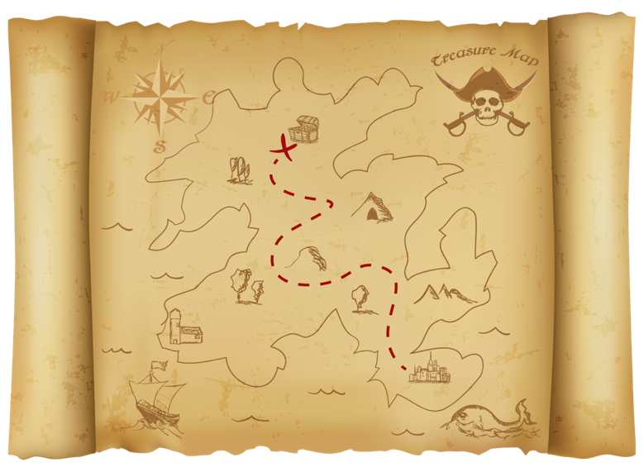




Treasure Hunt!!!
Notes:
Segue in:
“Taylor’s so excited to have so many awesome new friends – especially with the cruise ship Treasure Hunt about to start! Because she was a part of the JLY program, she knows how important it is to include her new friends, Polly, Andy and Vince, in the activity, and they decide to form a team.”
Story:
Some of the crew members are concerned that Taylor’s friends may struggle with the challenges but Taylor and her friend form a team. Insisting that activities aren’t always about winning – participating in the activity with her friends will be enjoyable
There are three clues to solve.
There are different prizes for teams that finish the quickest, are the most creative with their solutions and teams that display the best team work.
Segue out:
“Are you ready to begin?”

Slide 24

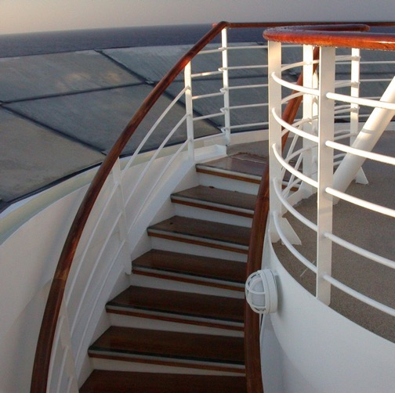
Clue 1
Run to the top
of the stairs
and find a box.
Inside you’ll
find the clue.
Notes:
Segue in:
“Here’s the first clue!”
Activity:
Ask a student to read the clue to the class.
Establish that everyone has to run up to the top deck.
Encourage kids to stand on the spot and run.
“But wait! What about Polly? She’s in a wheelchair and can’t run up stairs.”
Allow kids to discuss how they can help Polly reach the top deck. (Use elevator, find a ramp.)
What are some of the challenges that Polly has overcome? How can we help?
Segue out:
“When Taylor and her friends make it to the top deck, everyone is still looking for the next clue. Only Polly sees it – it’s hiding under a bench!”

Slide 25

Clue 2
Go to the
dance party,
perform your
favourite dance,
find the DJ and
ask for the clue!
Notes:
Segue in:
“Here’s clue number 2!”
Activity:
Ask a student to read the clue to the class.
Establish that the team has to go to the dance party and ask the people there if they have the clue.
Encourage kids to walk around asking each other if they have the clue.
“But wait! What about Andy? He has autism and doesn’t like too much noise or talking to lots of strangers.”
Allow kids to discuss how they can help Andy.
“What are some of the difficulties that Andy is facing? How could we overcome these challenges? What are some of the emotions/feelings Andy would be having in the dance club?”
Segue out:
“Taylor remembers that there are earmuffs in the club, Andy finds a pair and the team is ready to take on the challenge. With the support of his team Andy asks around. Andy finds the DJ and she gives him the last clue!”

Slide 26

Clue 3
For your last task
Make your way
to the Basketball courts. Everyone throw a ball
through the hoop!
Notes:
Segue in:
“It’s the last clue!”
Activity:
Ask a student to read the clue to the class.
Establish that everyone has to go to the basketball courts and throw a basketball through the hoop.
Encourage kids to stand on the spot and throw imaginary hoops.
“But wait! What about Vince? He has a visual impairment, and can’t see the hoop.”
Allow kids to discuss how they can help Vince throw the ball. (Give him directions, give him lots of positive encouragement.)
What are some of the challenges that Vince has overcome in the treasure hunt?
Segue out:
“Vince gets the ball through the hoop.”

Slide 28
Winners!
Notes:
Segue in:
“Taylor’s team wins a prize!”
If students ask about the prize, facilitator can work through the following discussion:
- What do you think their prize should be?
Students can pick the prize for Taylor and her friends – suggestions might include vouchers, a party, a game, VIP treatment on the cruise.
Discussion:
Everyone was so impressed with the groups positive attitude and their great team work.
How did they do this? Team work, inclusion and supporting each other
How did they achieve their result? They were positive and made some adjustments
Was it hard or difficult?
Segue out:
We now know that there are many different kinds of disabilities, and we saw that it was more difficult for Andy, Polly and Vince to do some things we thought were easy.

Slide 29
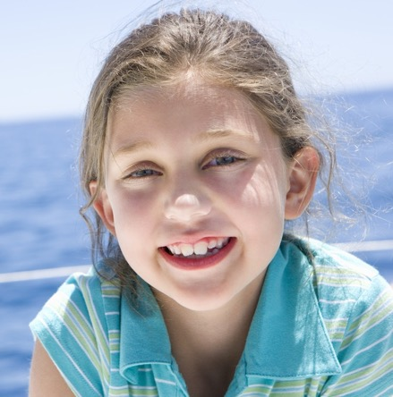
See you
next time!
Notes:
Segue in:
“Now, before I go, I’m going to ask you to do one thing...”
Activity:
Facilitator to ask the students to think about what everyday challenge might be harder for someone with a disability.
Students to offer suggestions – walking up stairs, riding a bike, sitting in a loud school assembly, etc.
Segue out:
“It’s been so great being here today with you guys! I hope that now you know how things might be harder for someone with a disability, we can start to think about how to make it easier. Now, please give your attention back to your teacher.”

Slide 30
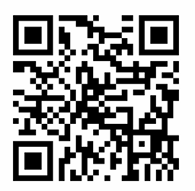
Thank You
bit.ly/3teachersurvey

